Slide 1
XingQiao event managment platform
Vahagn
Simon
2023-06-18

Slide 2

Content
1
Product Features and Innovations
2
Architecture and Key Technologies
3
Division of Labor
4
Conclusion

Slide 3
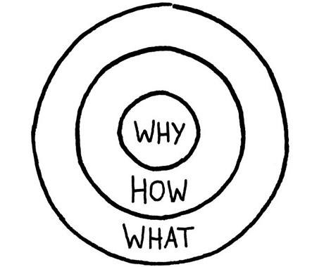
Brief Introduction
Why: Lack of centralized platform for students to create and promote events.
How:
Integrate key event planning tools in one user-friendly platform.
What:
Centralized platform where students, teachers, and organizations can create, browse, join, and manage academic and social events in campus.

Slide 4
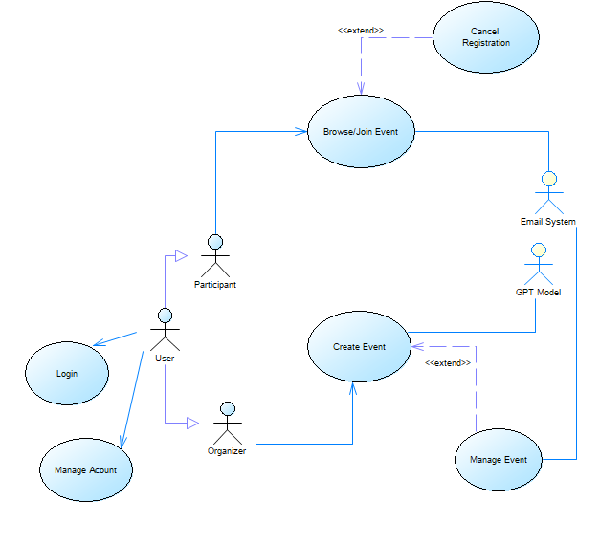
Product Features
Use cases:
- log in
- manage account
- cancel registration
- browse/Join event
- create event
- manage event

Slide 5
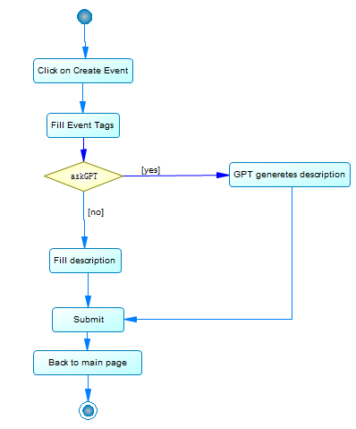
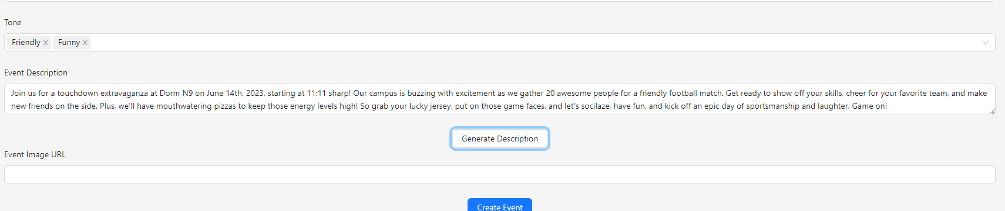
Brief Introduction
Demnostration of create event use-case
Create Event diagram

Slide 6
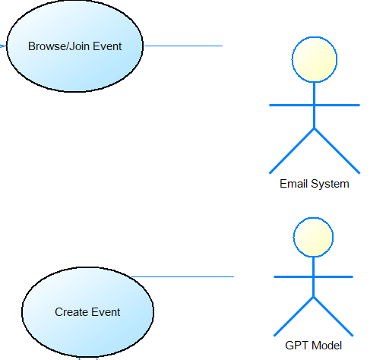


Innovations
Allow students to create thier onw events
Integrated Email System
Integrated GPT AI system

Slide 7
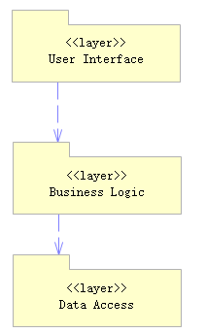




Architecture and Key Technologies
User interface (front-end): implemented by React Naive Web Application
Buisness logic (back-end): implemented by Python flask app and Java spring Boot app
Data Access (datrabase): implemented by Spring Boot JPA and MySQL

Slide 8
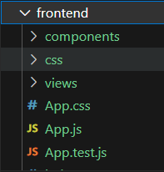
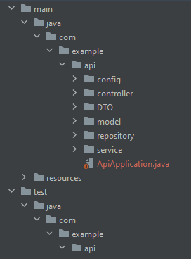
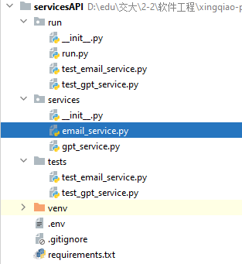
Architecture and Key Technologies
frontend - develped by Javascript React framwork, presenting all user interface features
backend - develped by Java Spring boot framework, responsible for all buisness logic and data access
ServicesAPI - develped by Python Flask framwork, handling Email and GPT services

Slide 9
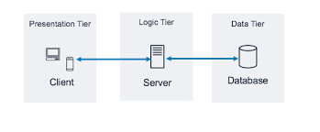
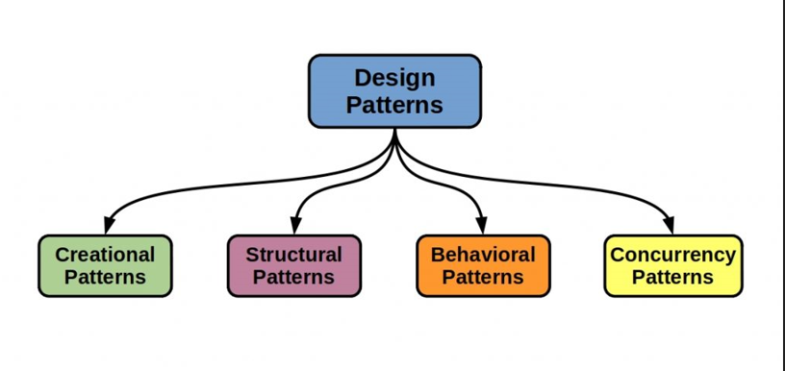
Characteristic
Architecture Style:
3-tier client-server model
Design patterns:
Creational: Abstract Factor (Java, Python),
Singleton (Spring Boot)
Structural: Composite (React)
Behavirol: State (React), Decorator (Python)
Concurrency: Async/Await(React)

Slide 10
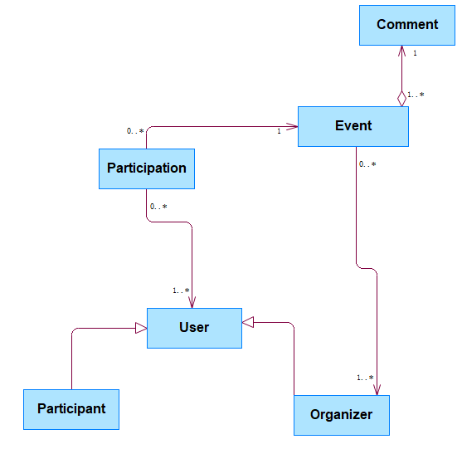
Conceptual Model
Participation class:
Many to Many map for user and Event

Slide 11
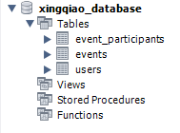
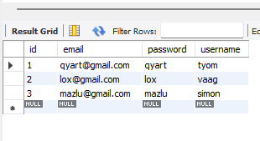
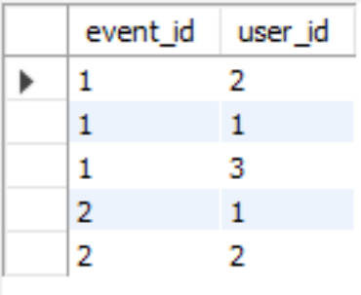
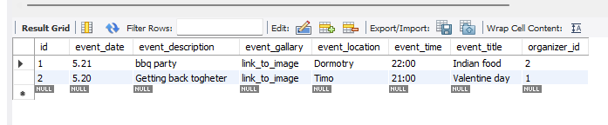
Database Design
Main schema
Users
Participations
Events

Slide 12
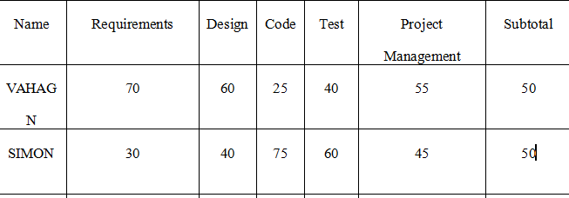
Division of Labor
Initially: 3 members
In the middle of the project: core member and group leader (SHUEN LIN) got a suspension for one year from the university
Stress and uncertainty
Eventually, we distributed the tasks assigned to her between the two of us and finished the project.

Slide 13
To Do List
More Unittests for Java and Js
System testing
Increase front-end usability and navigability

Slide 14
Lessons Learned
Time Management: Starting earlier allows for more time to handle unexpected challenges.
Teamwork: Communication is a key.
Planning: Detailed planning can help identify tasks and be specific. Dedicate good chuck of time to it.
Learning Curve: New technologies require time to learn.
Testing: Regular testing helps catch issues early.

Slide 15
Thanks!

